Slide 1



Answering case study questions
Exam questions that ask you to analyse case studies (also called scenarios) are usually designed to test your ability to relate theories and concepts to real-world situations
Dr Ainurul Rosli
Jul 28th 2020

Slide 2
Why case study released in advance
The case study is made available on blackboard in advance of the exam.
It is expected that students will read and study the document closely and that they will be extremely familiar with it on the day of the exam.
It describes an entity, providing background information on its industry and other information that should help candidates to understand any issues that arise.
This will provide students an opportunity to know more about the industry and topic of focus
students are expected to have already studied the syllabus material that is relevant to their case study

Slide 3
Reading and understanding the case study
It is quite common for the questions and your answers to repeat/include key facts from the case study
the expectation is that students will develop an awareness of the way the syllabus knowledge that they bring into the case study should be applied.
The initial read through the pre-seen should involve thinking about:
The industry
The firm
The issue of focus
Students should always ensure that they understand the content of the pre-seen.
The fact that you have had several weeks to study it suggests that you should have been able to take time to interpret the facts that have been provided and search more information/facts to supplement the case.
Notes:
Making full sense of the questions and case requires careful study and preparation.
independent reading and research can benefit case study preparation.

Slide 4
Prefabricated answers and question spotting
Students can improve their marks by studying the pre-seen case and thinking about what might happen in this particular case study, to this particular company.
However, students should resist the temptation to read the pre-seen with a view to predicting the tasks that will be set and concentrating their revision on the related topics
Question spotting is dangerous because it risks candidates excluding topics from their revision that could form the basis of a task in the exam.
The fact that the information in the pre-seen could lend itself to a particular topic does not guarantee that the topic will be examined.
It should be stressed that it would be potentially helpful to read the pre-seen carefully with a view to understanding the business and the challenges that it might face.
Problems only arise when candidates do not prepare themselves to adapt to changing scenarios or unexpected events.

Slide 5
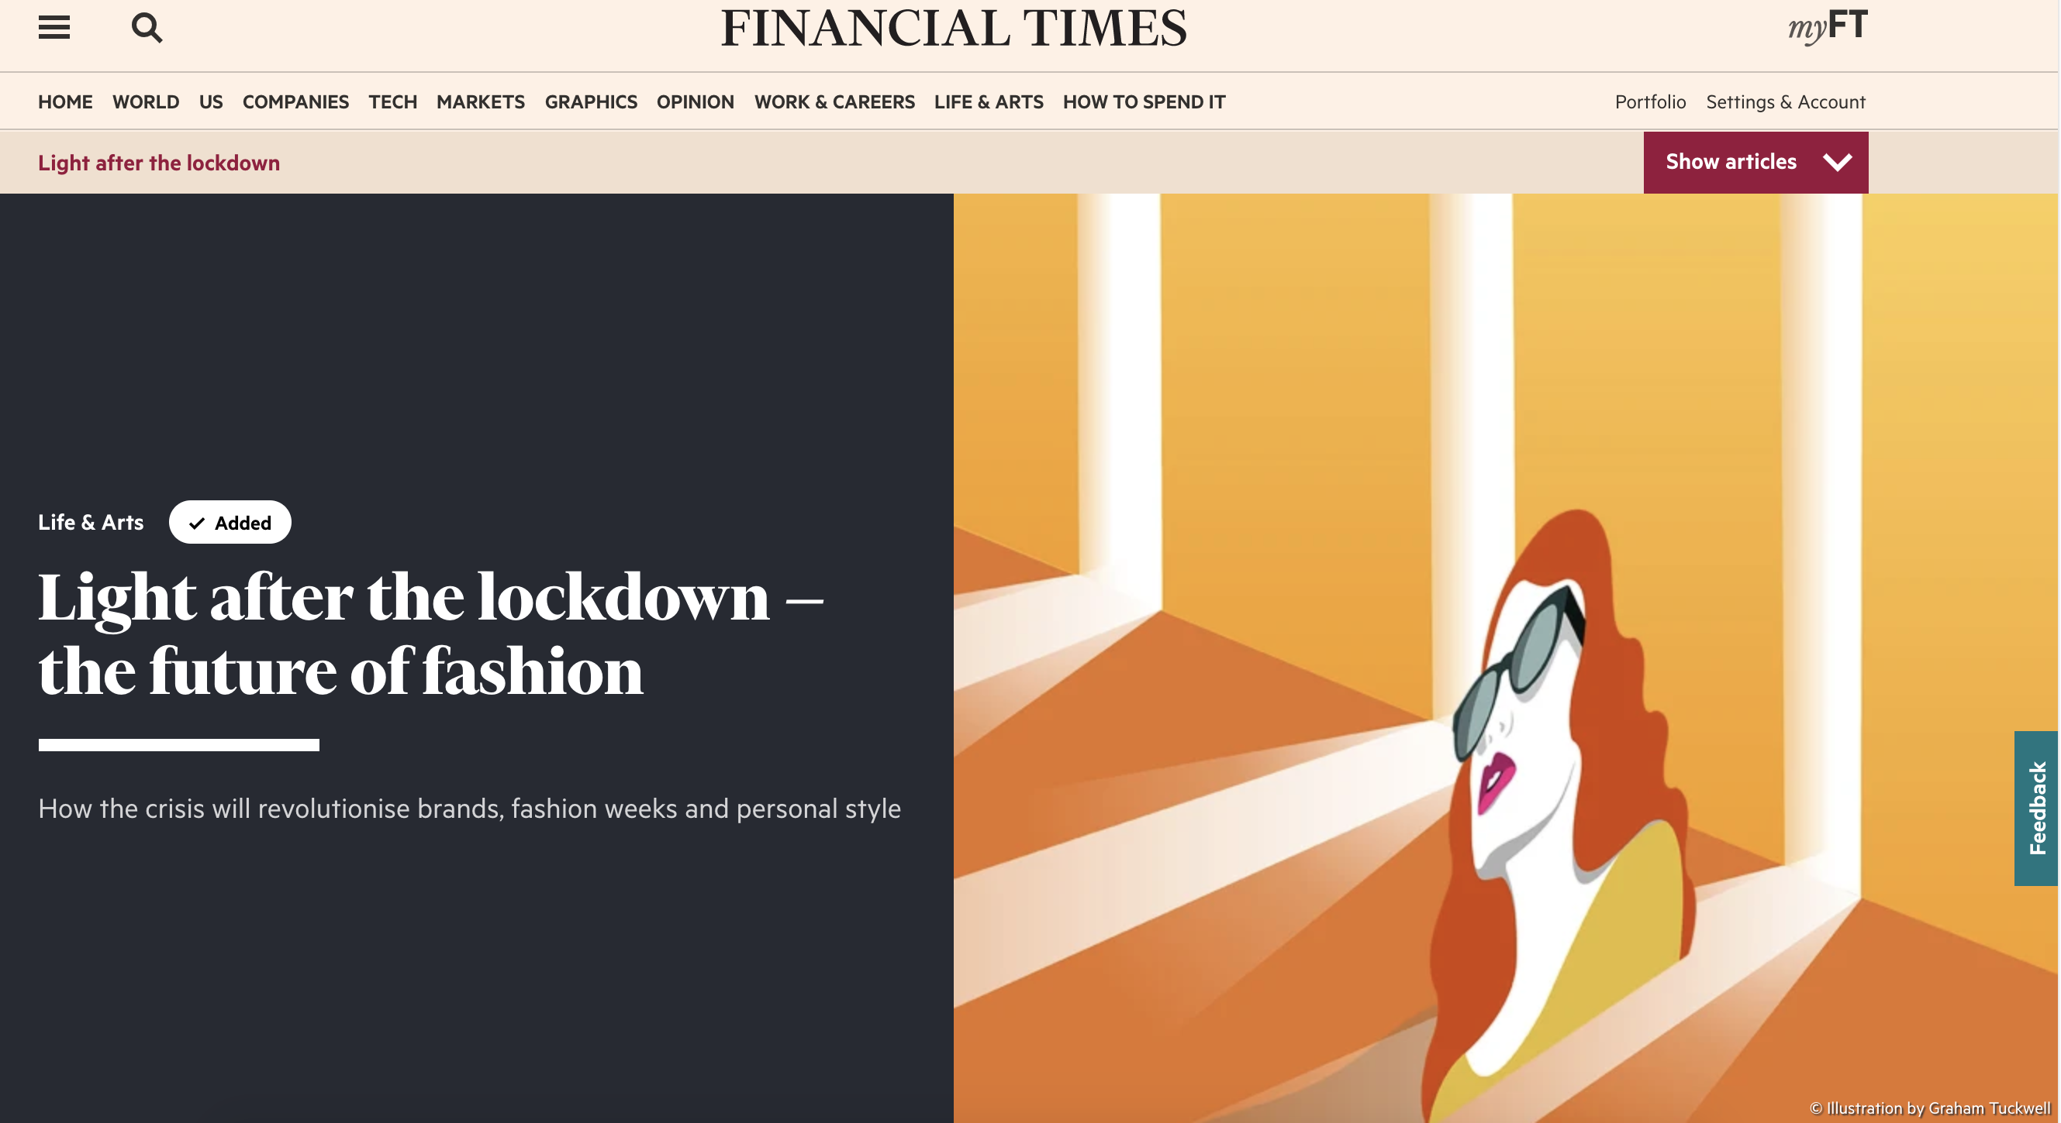
Understanding the case study for question spotting
https://www.ft.com/content/1b03efec-8895-11ea-a01c-a28a3e3fbd33

Slide 6

Understanding the case study for question spotting
https://www.ft.com/content/1b03efec-8895-11ea-a01c-a28a3e3fbd33

Slide 7
During the exam
Read the exam question(s)
Then skim read the case study to get the general idea. Highlight or underline key points
Answer the question linking relevant theories and concepts to specific information from the case study. Usually you will need to write your answers in clearly formed paragraphs which have a clear topic that is well-supported with evidence and examples.
Instead of simply describing or restating information from the case itself, use specific details or examples to support the points you are trying to make. This is where you link theory to the facts from the case study.

Slide 8
How it will be marked
When marking case study exams, it is clear that many students conduct their own independent study of the industry and the factors that affect it.
Marks are awarded for arguments & information that are both correct and relevant, so illustrating an argument with a real-world event that bears no relation to the case will simply waste time.
Rather than researching the industry in very narrow terms, students might benefit more from keeping up to date with the general business news
Many students gain credit simply by demonstrating that they have a good grasp of the issues that might affect, say, an industry and applying that understanding to the case study and its associated requirements.

